Slide 1


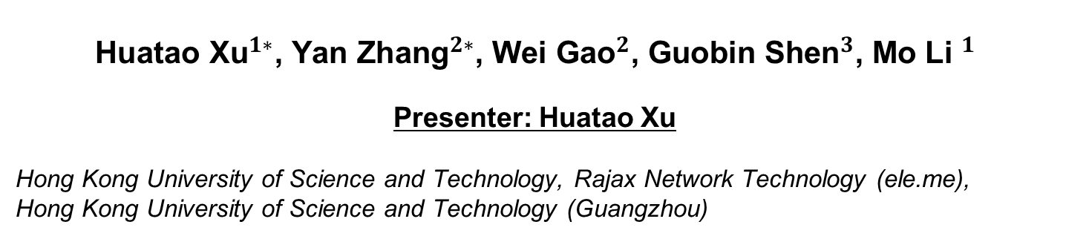
Experience Paper: Adopting Activity Recognition in
On-demand Food Delivery Business
$$\text{Huatao} {\text{Xu}}^{1∗}\text{, }{\text{Yan} \text{Zhang}}^{2∗}\text{, }{\text{Wei} \text{Gao}}^{2}\text{, }{\text{Guobin} \text{Shen}}^{3}\text{, }{\text{Mo} \text{Li} }^{1}$$
Presenter: Huatao Xu
Hong Kong University of Science and Technology, Rajax Network Technology (ele.me),
Hong Kong University of Science and Technology (Guangzhou)

Slide 2
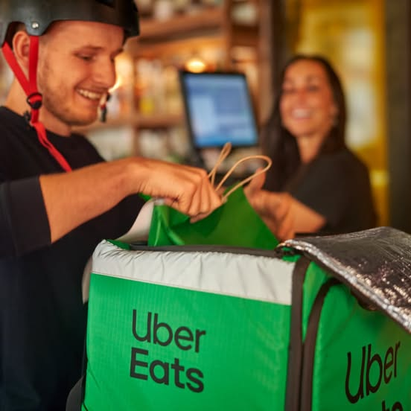
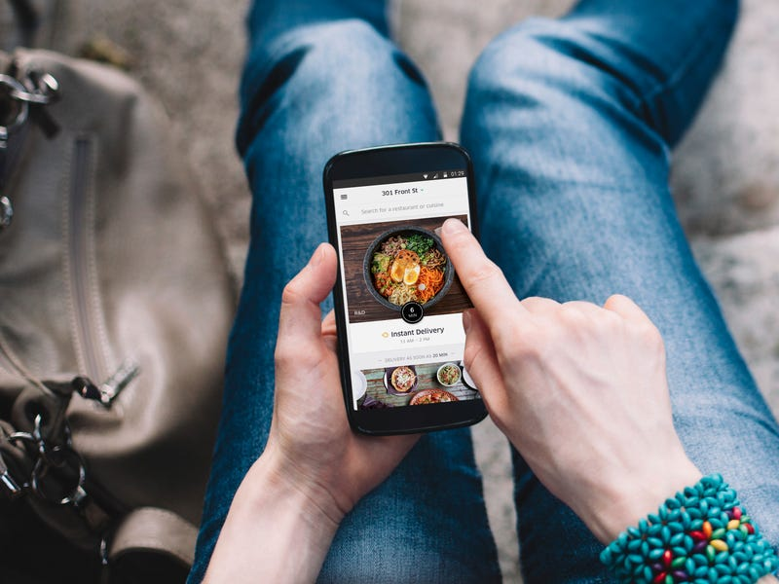
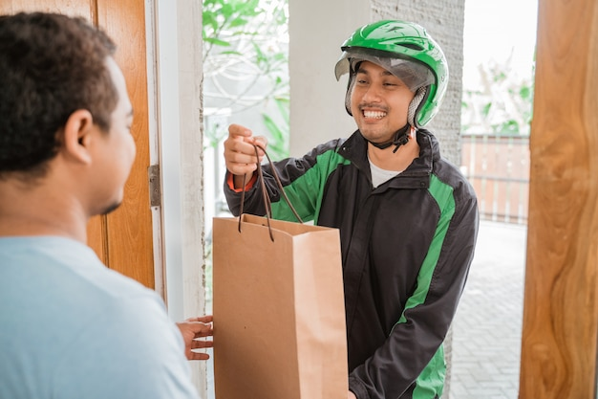
On-Demand Food Delivery

Slide 3
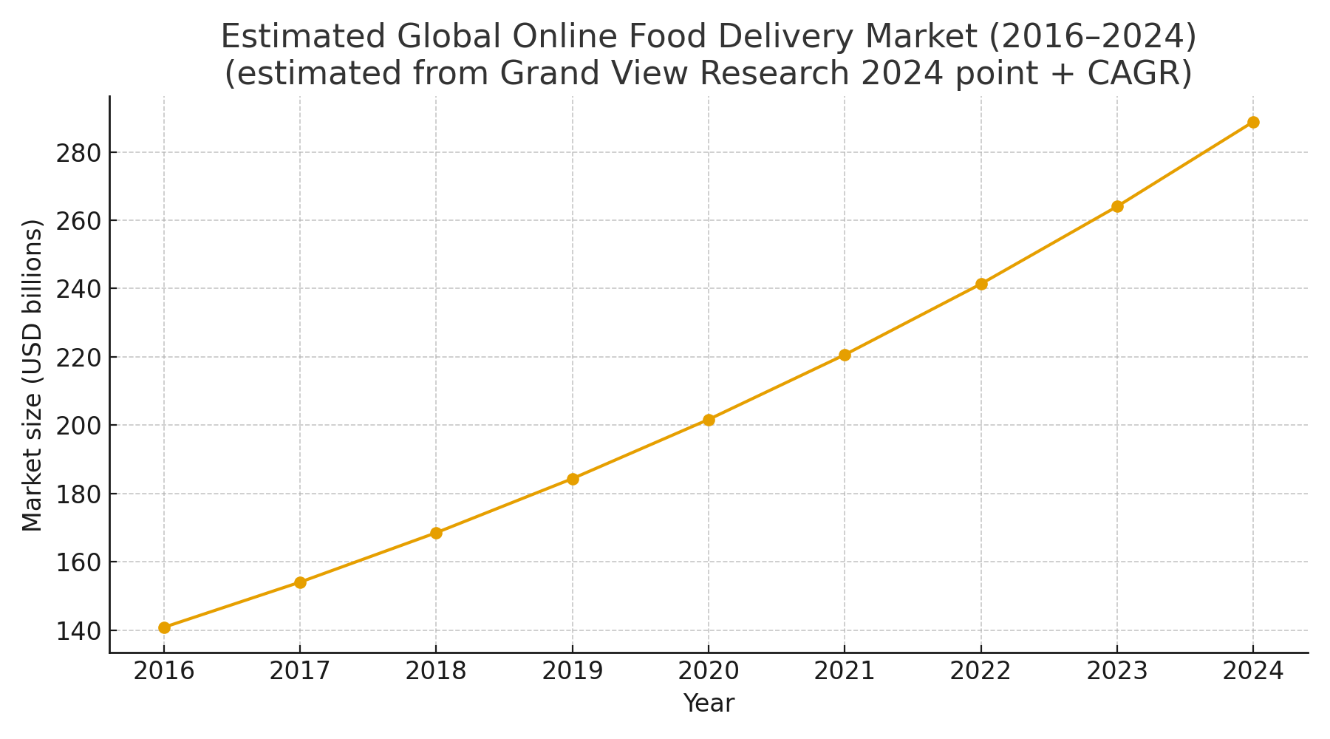
On-Demand Food Delivery Business
https://www.grandviewresearch.com/industry-analysis/online-food-delivery-market-report

Slide 4










On-Demand Food Delivery Business

Slide 5
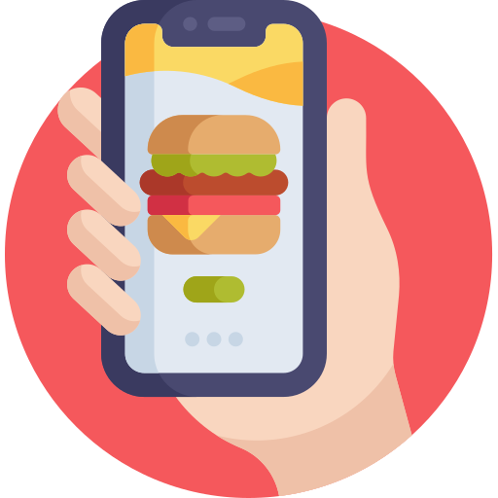






Key Motivation
Place Order
Send Order
Customer
Platform
Restaurant
Assign
Order
Optimized Decision
GPS
Locations
Activity
Status
Courier

Slide 6



Add Value of Human Activity Recognition
Courier
Customer
Order received
Food received
Restaurant
Arrival at restaurant
Food ready

Slide 7


Add Value of Human Activity Recognition
Courier
Customer
Order received
Food received
Restaurant
Arrival at restaurant
Food ready
Activity Status are Strong Clues!

Slide 8
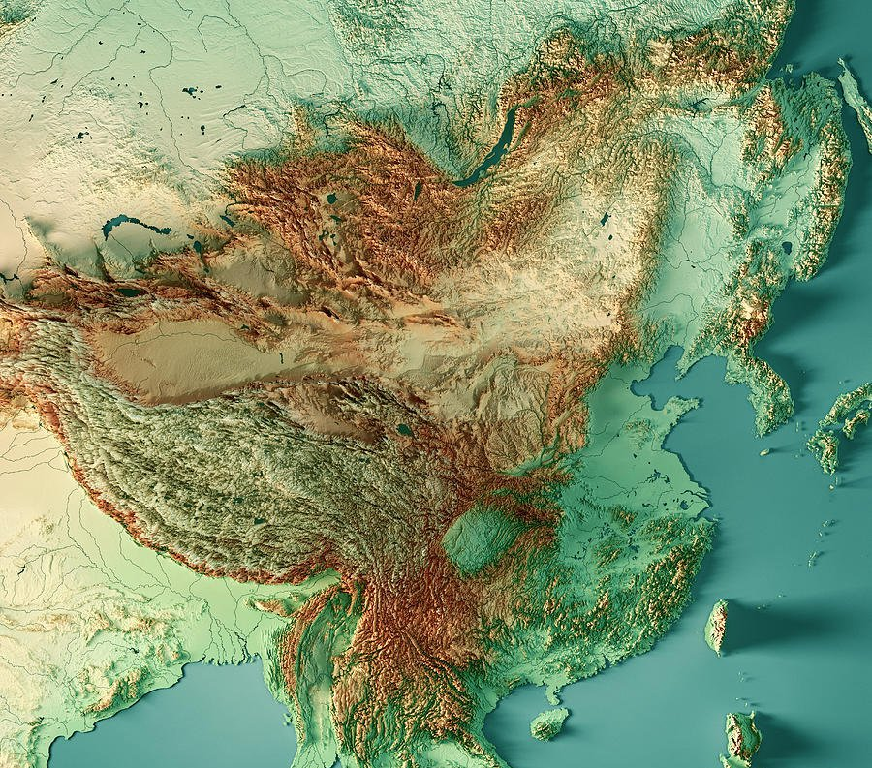
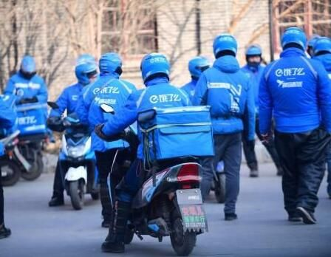
Nationwide Human Activity Recognition
Data Distribution
How to build a generalizable model?

Slide 9
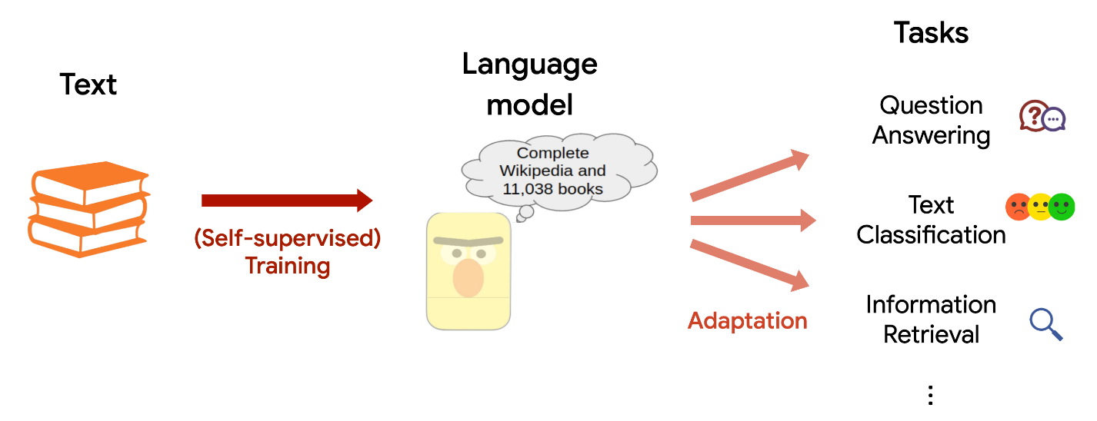
Nationwide Human Activity Recognition
Building foundation model for sensor data.
[1] https://cs.stanford.edu/~myasu/blog/dragon/

Slide 10

LIMU-BERT
A pioneering sensor foundation model.
MLM
Classifier
NSP
Classifier
Task
Classifier
MLM
Classifier
NSP
Classifier
Task
Classifier
BERT
BERT
Text Data
IMU Data
[1] Xu, Huatao, Pengfei Zhou, Rui Tan, Mo Li, and Guobin Shen. "Limu-bert: Unleashing the potential of unlabeled data for imu sensing applications."
SenSys 2021. Best Paper Runner-Up Award.

Slide 11
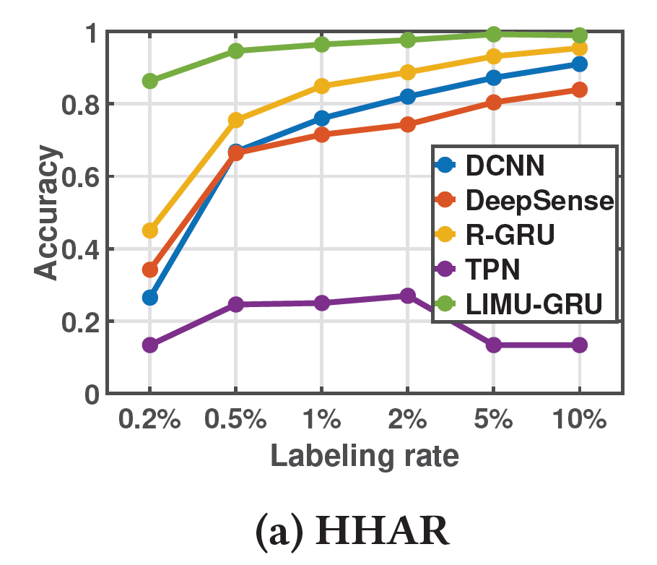
LIMU-BERT
A pioneering sensor foundation model.
MLM
Classifier
NSP
Classifier
Task
Classifier
MLM
Classifier
Task
Classifier
BERT
BERT
Normalization & Fusion
IMU Data
Text Data
[1] Xu, Huatao, Pengfei Zhou, Rui Tan, Mo Li, and Guobin Shen. "Limu-bert: Unleashing the potential of unlabeled data for imu sensing applications."
SenSys 2021. Best Paper Runner-Up Award.

Slide 12
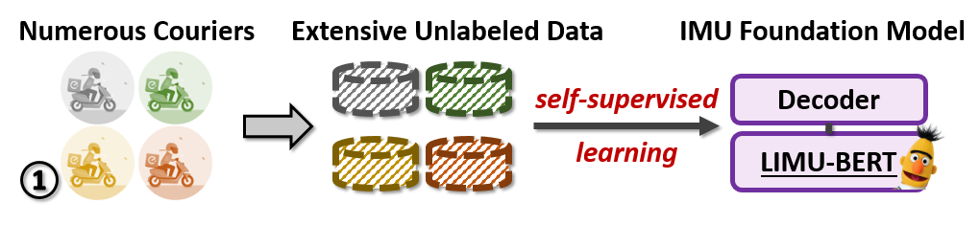
LIMU-BERT for Ele.me

Slide 13
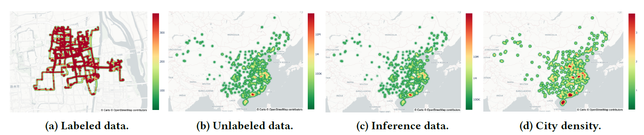
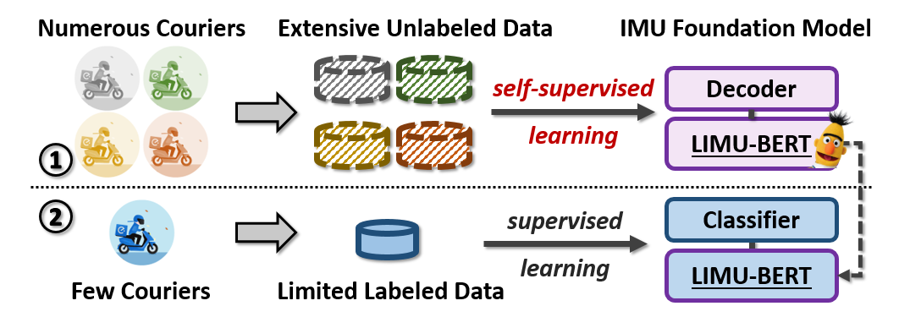
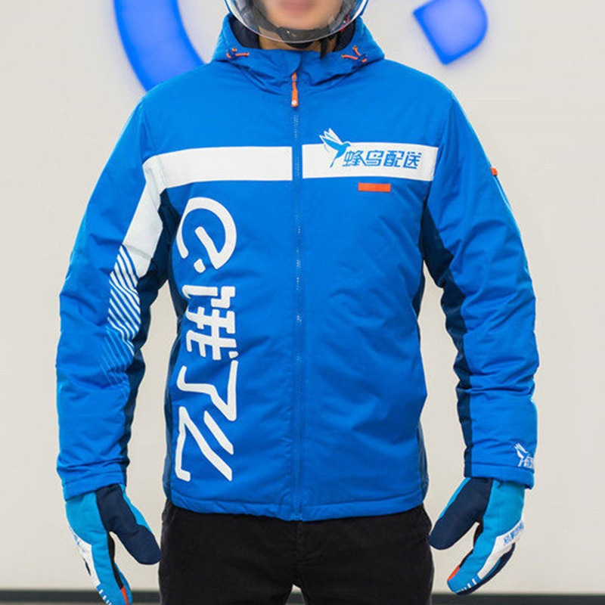
LIMU-BERT for Ele.me
Camera

Slide 14
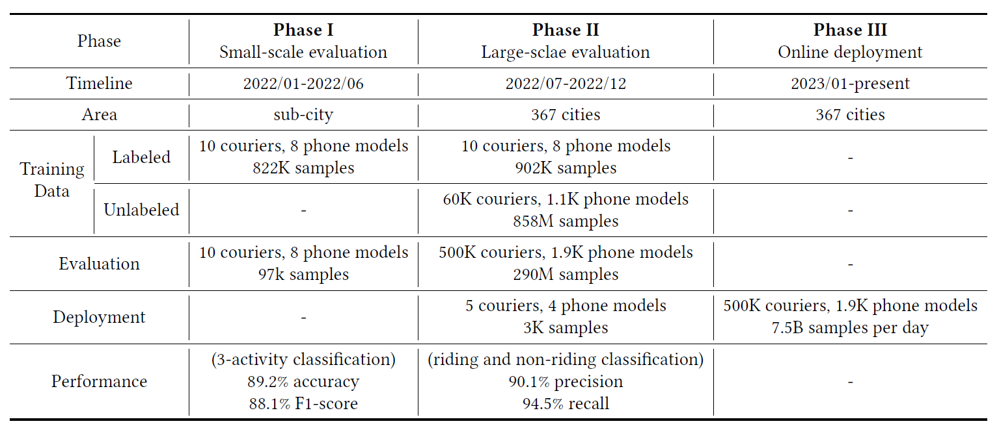
Nationwide Deployment

Slide 15

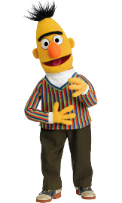
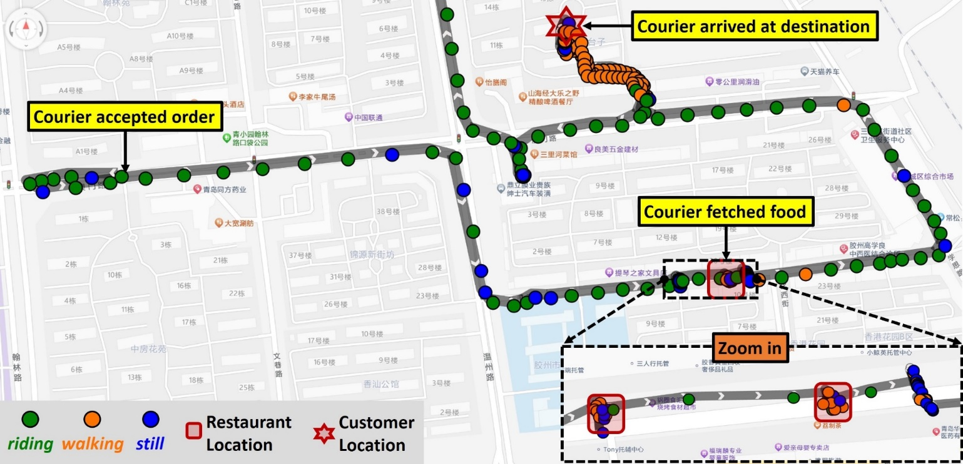
Downstream Applications
LIMU-BERT
Activity
Recognition
Trajectory
Segment

Slide 16
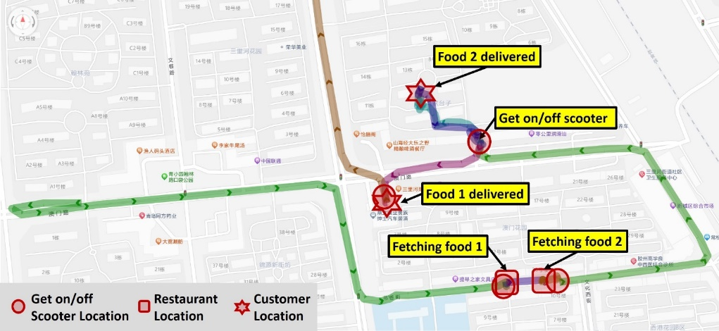
Downstream Applications
LIMU-BERT
Activity
Recognition
Trajectory
Segment
Navigation
ETS*
ETA*
*ETS denotes the Estimated Time of Stop and ETA denotes the Estimated Time of Arrival.

Slide 17
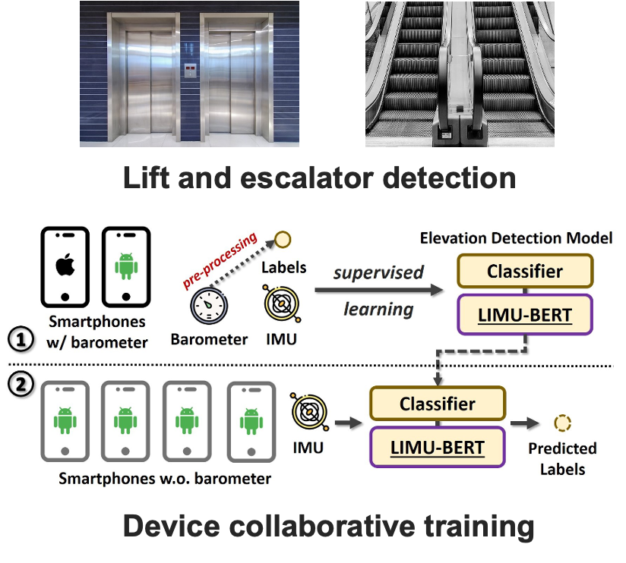
Downstream Applications
LIMU-BERT
Activity
Recognition
Elevation Change Detection
Trajectory
Segment
Navigation
ETS*
Most Android smartphones are
not equipped with barometer!
ETA*

Slide 18
Downstream Applications
LIMU-BERT
Activity
Recognition
Elevation Change Detection
Trajectory
Segment
Navigation
ETS*
ETA*

Slide 19
Downstream Applications
LIMU-BERT
Activity
Recognition
Elevation Change Detection
Trajectory
Segment
Navigation
ETS*
Difficulty Analysis
Other factors
e.g., distance
With approximately 20 million orders processed daily, the average fee decrease of 0.06 yuan per order results in an estimated annual savings of around 0.44 billion CNY.
ETA*
Pricing Strategy

Slide 20
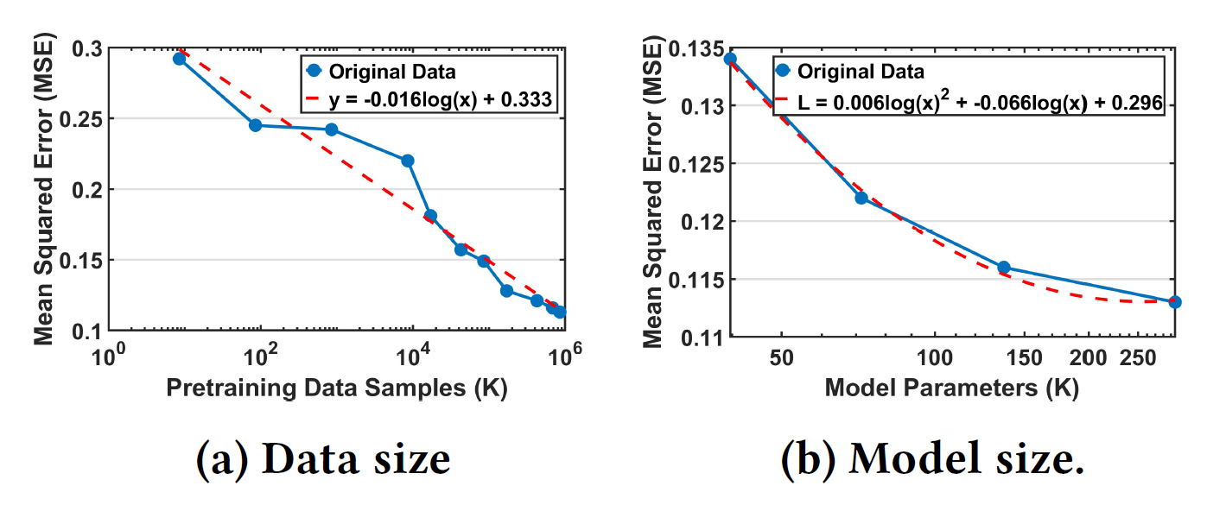
Lessons Learned
Scaling law for sensor foundation model.

Slide 21
Lessons Learned
Evaluating models at large scale:
Derive riding and non-riding labels from Indoor/Outdoor detection and GPS speeds.
Handling diverse devices:
About 11% (57,000) of devices lack gyroscope sensors!
Some devices are unable to reliably report sensor data at 10 Hz!
Sensor and device collaboration
Derive elevation-change labels from iOS devices to train models for Android devices.

Slide 22
Conclusion
We showcase the practical value of leveraging human activity recognition technology in real-world commercial applications.
We share experiences and lessons learned in the training, evaluating, and deploying deep learning-based HAR models for large-scale scenarios.
We will open-source our LIMU-BERT, pre-trained with approximately 1.43 million hours of sensor data from 60K subjects and 1.1K phone models, to support further studies and advancements in the field.

Slide 23
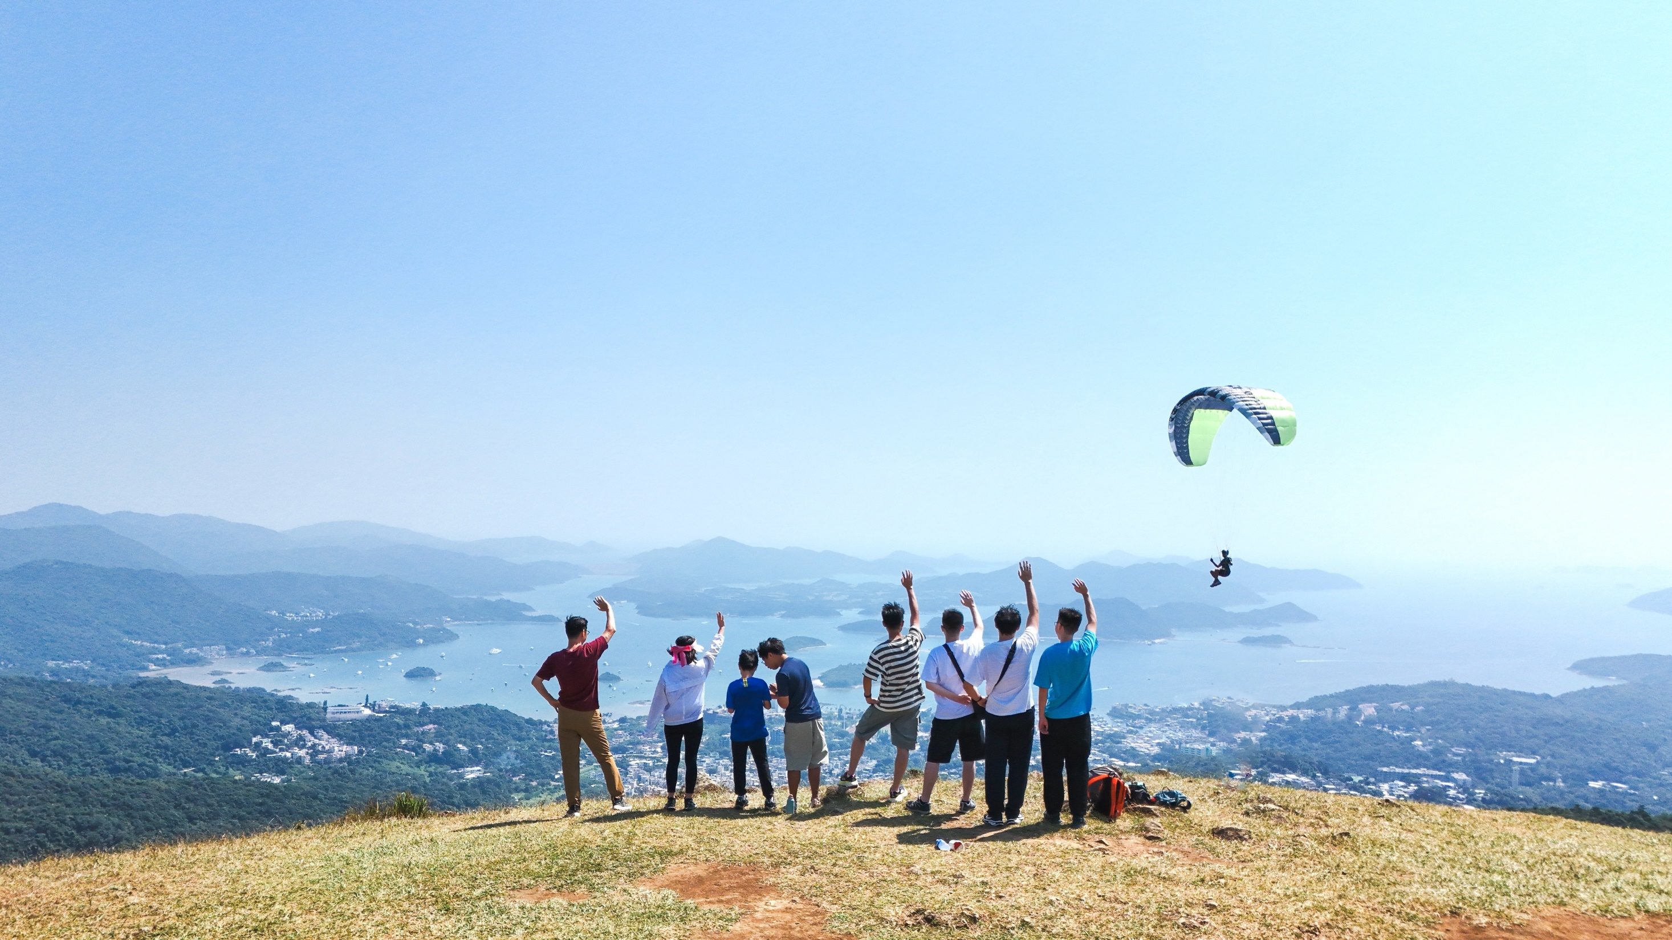

Thanks!
https://wands.hk

